Slide 1


Slide 2
Middleware
Generally speaking, middleware provides software services for application programs above the basic operating system and networking services.
Brings interoperability
Bridging heterogeneous systems
Middleware is a layer between the operating system and applications that provides a set of services.
Three major types of middleware for mobile computing— middleware to support application adaptation, mobile agent systems and service discovery frameworks.

Slide 3
Middleware
Middleware presents an abstract interface to the application that provides the application developer with a uniform view of lower-level operating systems and networks.
In wireless mobile environments, middleware must be flexible to enable adaptation to changes in…
  the underlying operating systems and networks, and
  application requirements

Slide 4
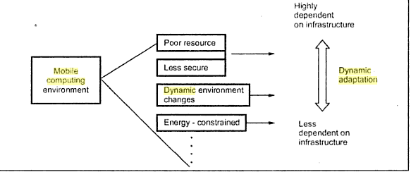
Adaptation

Slide 5
Adaptation
Mobile applications must adapt their behaviors and expectations to conserve scarce resources and to adjust quality of service (QoS)—essentially, a guarantee of performance—to sustainable levels.
Adaptation middleware monitors resources, drawing on policies determined by the users or by the application developers to assist applications in modifying application expectations to match available resources.
In adapting, a mobile application typically does not change its core behavior— a video player remains a video player—but instead takes its user down a slightly different road, increasing or decreasing the fidelity of the data stream delivered to the user.

Slide 6
Agents
Put the action where the data are, allowing programs to move autonomously about a network in order to access remote resources and migrate again.
Program that can migrate from system to system within a network environment
Performs some processing at each host
Agent decides when and where to move next
How does it move ?
Save state
Transport saved state to next system
Resume execution of saved state

Slide 7
Agents
In a mobile agent system, programs migrate directly to servers, gain access to data or computational resources, and potentially migrate again, eventually returning to their “home base” to deliver results.
The benefit of having mobile agents is that disconnected operation is easily supported—a mobile user can dispatch an agent, disconnect and then reconnect later to allow the agent to return home.
Another benefit is that agents can gain access to large amount of data to solve a problem even if a mobile user’s network resources are scarce.
Another benefit is that the mobile agent system allows the functionality of the servers to be expanded dynamically.

Slide 8
Service Discovery
Service discovery middleware extends the client-server (CS) paradigm to include dynamic discovery of services and more dynamic interaction between clients and services.
This type of middleware directly supports the extended client server model.
Works for wired and wireless networks.

Slide 9
Service Discovery
For example, imagine a mobile user with a service discovery–enabled PDA, sitting in a coffee shop, sipping a cup of coffee.
The user is not familiar with the city she is visiting but decides to see a movie.
Her PDA dynamically discovers the Bluetooth access point attached to the ceiling of the shop, using the Bluetooth Service Discovery Protocol.
She then uses a search engine on the Web to locate a nearby movie theater and determine the show times.

Slide 10
spectrum of adaptation
At one end of the spectrum, adaptation may be entirely the responsibility of the mobile computer’s operating system (OS).
At the other end, adaptation may be entirely the responsibility of individual applications; that is, each application must address all the issues of detecting and dealing with varying resource levels.

Slide 11
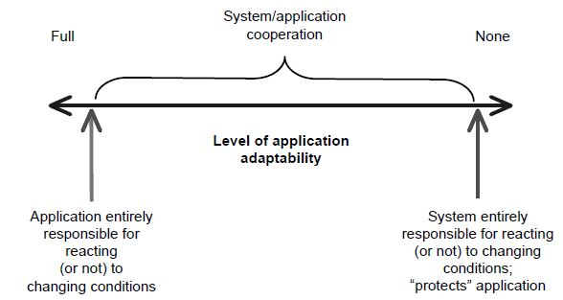
Spectrum of adaptation

Slide 12
Adaptation may be the responsibility of mobile computer’s operating system or of the individual application.
Between these two extremeities, a number of application aware strategies are possible where OS and individual application share some of the burden of the adaptation
Resource Monitoring:
  Cash monitoring
  ACPI for power

Slide 13
Adaptation Strategies
The Odyssey project (Noble et al., 1997; Noble, 2000) at Carnegie Mellon serves as a good model for understanding application-aware adaptation.
Satyanarayanan proposed several measures that are useful for classifying the goodness of an adaptation strategy i.e. fidelity, agility, and concurrency.
Dimensions of fidelity: frame rate, audio quality,
100% fidelity
Stale fidelity
Agility
An adaptation middleware’s agility directly limits the range of fidelity levels that can be accommodated.
Concurrency

Slide 14
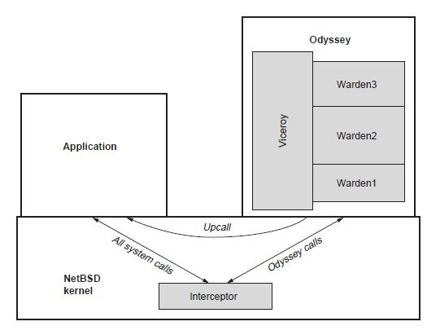
Adaptation Strategies

Slide 15
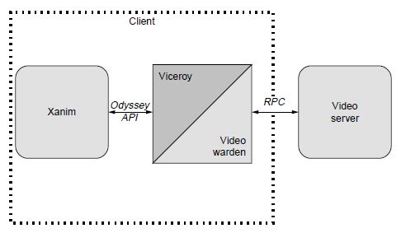
Sample Odyssey Application

Slide 16
Mobile agents
Mobile agents are a significant step forward in sophistication, supporting the migration of code as well as state.
Mobile agents move freely about a network, making autonomous decisions on where to travel next, extracting data and communicating with other agents inorder to meet mission goals.
Mobile agent system is a dynamic client server architecture that support migration of mobile application(agents) to and from the remote servers.

Slide 17
advantages
Technical advantages are:
  The limitation of single client computer are reduced
  The ability to customize applications easily is greatly improved
  Flexible, disconnected operation is supported

Slide 18
Service Discovery Protocol: Common Ground
A common ground among the service discovery protocol suites has been discussed looking at the common characteristics.
Most service discovery frameworks address a large subset of the following concepts:
  Standardization of services: Service types are standardized to support dynamic discovery of services. This includes operations that the service supports, the protocols it uses, and descriptive attributes that provide additional information about the service.

Slide 19
  Discovery of Service: Needed services may be discovered on demand with minimal prior knowledge of the network. Clients can search for service either by service type or service description attributes.
  Service subtyping: Clients may be interested in specific type of service e.g. high resolution color printer required to print photo. In other cases black and white printing service is required. Service subtyping allows clients to specify a needed service type with required detail.

Slide 20
  Service insertion and advertisement: Service advertisement allows dynamic insertion into and removal of services from the network, providing an extension of plug and play technologies into a networked environment. Services slip into a network with minimum manual configuration and advertise their availability either directly to clients or to servers maintaining catalogs of services. Services leaving a network can advertise their departure.
  Service Browsing: browsing allows clients to explore the space of currently available services without prior knowledge of network environment and without any specific service types in mind. Information obtained through service browsing may be presented to user in a GUI and then user can select the service to interact with.

Slide 21
Service Catalogs: Services perform advertisement against one or more catalogs rather than interacting with the clients directly. Similarly clients query catalogs for needed services rather than searching the network for services. The advantages are greater flexibility in deploying services beyond the local network segment and a reduction in multicast traffic.
Eventing : Eventing allows asynchronous notification of interesting conditions e.g. a needed service becoming available or an important change in the state of the service such as printer running out of paper. An eventing mechanism provides more timely notifications of important events.

Slide 22
Garbage collection: it facilitates remove outdated information from the network, including advertisements associated with dysfunctional services and subscriptions to eventing services. Otherwise clients try contact non-existence services or services continue to perform operations on behalf of crashed clients. Critical for proper operation of service catalog.
Scoping: scoping is addressed in two different ways. First way controls the extent of multicast communication by using administratively scoped multicast to administratively control the radius of multicast advertisement and discovery in order to limit traffic on network. The other sort scoping associates names with services to create service groups.

